Slide 1
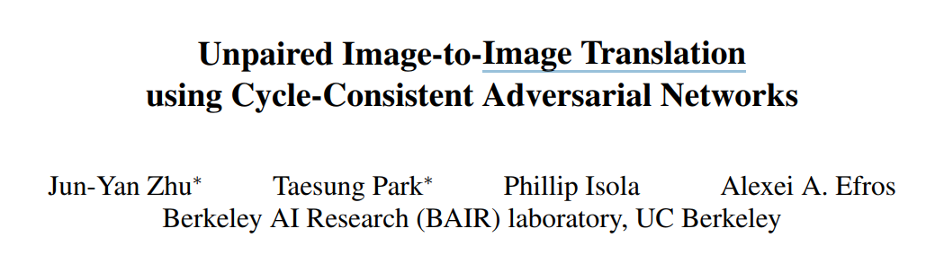
ICCV 2017
Yu - Hsiang Cheng

Slide 2
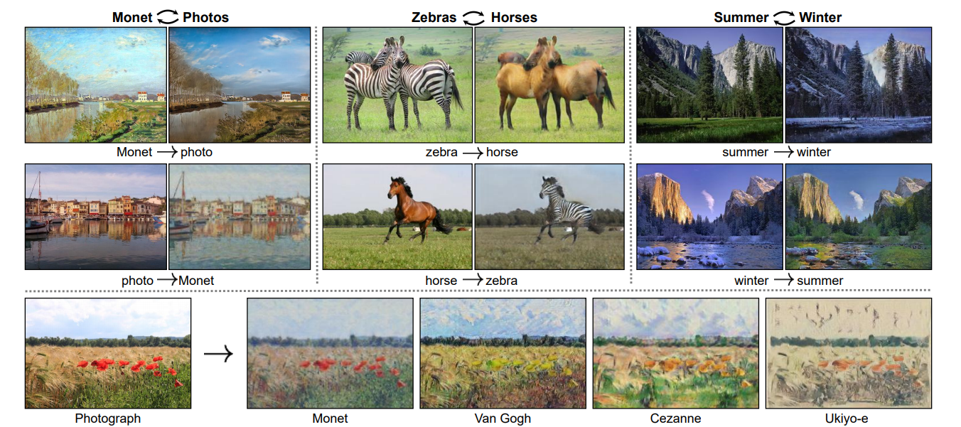
Automatically “translate” as image from one into the other and vice versa

Slide 3
Abstract
Image-to-image translation is a class of vision and graphics problems where the goal is to learn the mapping between an input image and an output image using a training set of aligned image pairs.
for many tasks, paired training data will not be available

Slide 4
Abstract
present an approach for learning to translate an image from a source domain X to a target domain Y in the absence of paired examples.
learn a mapping G : X → Y such that the distribution of images from G(X) is indistinguishable from the distribution Y using an adversarial loss.
Because this mapping is highly under-constrained, we couple it with an inverse mapping F : Y → X and introduce a cycle consistency loss to enforce F(G(X)) ≈ X (and vice versa).

Slide 5
Introduction
capturing special characteristics of one image collection and figuring out how these characteristics could be translated into the other image collection, all in the absence of any paired training examples.

Slide 6
Introduction
This problem can be more broadly described as imageto-image translation [22], converting an image from one representation of a given scene, x, to another, y, e.g., grayscale to color, image to semantic labels, edge-map to photograph.
Years of research in computer vision, image processing, computational photography, and graphics have produced powerful translation systems in the supervised setting

Slide 7
Introduction
obtaining paired training data can be difficult and expensive
For many tasks, like object transfiguration (e.g., zebra↔horse, the desired output is not even well-defined.

Slide 8
Introduction
We assume there is some underlying relationship between the domains– for example, that they are two different renderings of the same underlying scene – and seek to learn that relationship
Although we lack supervision in the form of paired examples, we can exploit supervision at the level of sets:

Slide 9
GAN
Generator network : try to fool the discriminator by generating real-looking image
Discriminator network : try to distinguish between real and fake image
Fake
/
Real
Random noise
Generator
discriminator
Data from real world

Slide 10
Introduction
G: X => Y
X
Y
Adversary trained to classify Y apart from y
Y
The optimal G thereby translates the domain X to a domain Y distributed
identically to Y .
However, such a translation does not guarantee that an individual input x
and output y are paired up in a meaningful way –
there are infinitely many mappings G that will induce the same
distribution over y
Notes:
不能保證X生成的Y hat 有意義 只是符合Y 分布

Slide 11
Introduction
Moreover, in practice, we have found it difficult to optimize the adversarial objective in isolation: standard procedures often lead to the wellknown problem of mode collapse, where all input images map to the same output image and the optimization fails to make progress

Slide 12
Introduction
These issues call for adding more structure to our objective. Therefore, we exploit the property that translation should be “cycle consistent”,
if we translate, e.g., a sentence from English to French, and then translate it back from French to English, we should arrive back at the original sentence

Slide 13
Cycle consistency loss
We apply this structural assumption by training both the mapping G and F simultaneously, and adding a cycle consistency loss [64] that encourages F(G(x)) ≈ x and G(F(y)) ≈ y. Combining this loss with adversarial losses on domains X and Y yields our full objective for unpaired image-to-image translation.

Slide 14
Pix2Pix
Pixel to Pixel Generative Adversarial Networks applies Conditional Generative Adversarial Networks as a general-purpose solution to image-to-image translation problems.
Generate : The key for generator is U-net architecture adding skip connections which shuttle low-level infomation shared between input and output images across net.
Discriminator: PatchGAN – that only penalizes structure at the scale of patches is applied as disciminator architecture. This discriminator tries to classify if each N × N patch in an image is real or fake

Slide 15
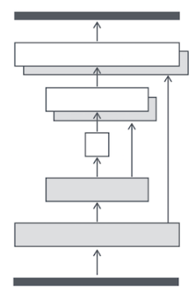
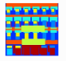
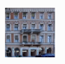
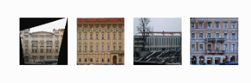
Pix2Pix
100 * L1Loss
discriminator

Slide 16
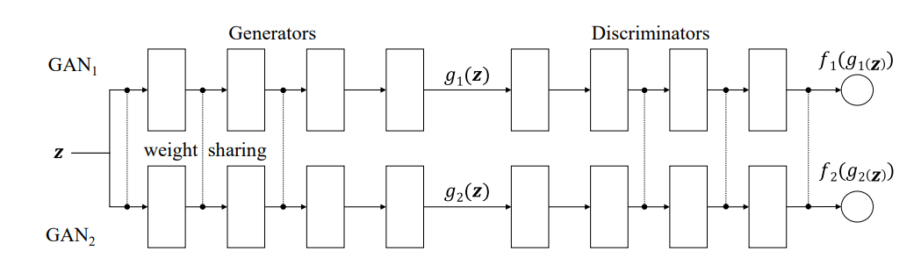
CoGan
CoGAN use a weight-sharing strategy to learn a common representation across domains.

Slide 17
CoGAN
g1(X)
D1(g1(X))
X
D2(g2(X))
g2(X)
Weight sharing

Slide 18
Cycle Consistency
In this work, we are introducing a similar loss to push G and F to be consistent with each other. Concurrent with our work, in these same proceedings, Yi et al. [59] independently use a similar objective for unpaired image-to-image translation, inspired by dual learning in machine translation

Slide 19
Our primary focus is learning the mapping between two image collections,rather than between two speciﬁc images, by trying to capture correspondences between higher-level appearance structures

Slide 20
Formulation
our model includes two mappings G : X → Y and F : Y → X. In addition, we introduce two adversarial discriminators DX and DY , where DX aims to distinguish between images {x} and translated images {F(y)}; in the same way, DY aims to discriminate between {y} and {G(x)}
Generator
Discriminator

Slide 21
adversarial losses for matching the distribution of generated images to the data distribution in the target domain.
cycle consistency losses to prevent the learned mappings G and F from contradicting each other.

Slide 22
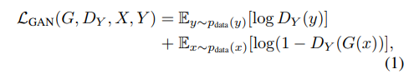
Adversarial Loss
G tries to generate images G(x) that look similar to images from domain Y , while DY aims to distinguish between translated samples G(x) and real samples y
G aims to minimize this objective against an adversary D that tries to maximize it

Slide 23
Cycle Consistency Loss
However, with large enough capacity, a network can map the same set of input images to any random permutation of images in the target domain, where any of the learned mappings can induce an output distribution that matches the target distribution. Thus, adversarial losses alone cannot guarantee that the learned function can map an individual input xi to a desired output yi .

Slide 24
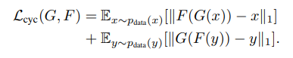
Cycle Consistency Loss
the image translation cycle should be able to bring x back to the original image,
i.e., x → G(x) → F(G(x)) ≈ x

Slide 25
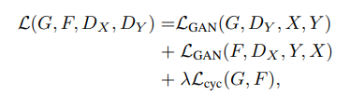
Full Objective
λ controls the relative importance of the
two objectives.
empirically show that both objectives play critical roles in
arriving at high-quality results.

Slide 26
Network Architecture
Conv2D(kernel=3,pad=1,stride=2)
InstanceNorm
Activatin(‘relu’)
Generator
ResBlock
Discriminator
Patch GAN

Slide 27
CycleGAN
L1LOSS
A
Gen_B
Rec_A
A
B
DB
B -> A
DA
L1LOSS
B
Gen_A
Rec_B
A -> B

Slide 28
Training details
Use LSGAN Loss
GAN loss LGAN(G, D, X, Y ),
we train the G to minimize Ex∼pdata(x) [(D(G(x)) − 1)^2 ]
and train the D to minimize Ey∼pdata(y) [(D(y) − 1)^2 ] + Ex∼pdata(x) [D(G(x))^2 ].

Slide 29
Result
first compare our approach against recent methods for unpaired image-to-image translation on paired datasets where ground truth input-output pairs are available for evaluation
We then study the importance of both the adversarial loss and the cycle consistency loss and compare our full method against several variants.

Slide 30
Evaluation Metrics
AMT perceptual studies:
Participants were shown a sequence of pairs of images, one a real photo or map and one fake (generated by our algorithm or a baseline), and asked to click on the image they thought was real.

Slide 31
Evaluation Metrics
FCN score
seek an automatic quantitative measure that does not require human experiments.
The FCN predicts a label map for a generated photo. This label map can then be compared against the input ground truth labels using standard semantic segmentation metrics

Slide 32
Semantic segmentation metrics
including per-pixel accuracy, per-class accuracy, and mean class Intersection-Over-Union.
Notes:
Pixel 對幾個
Class 對幾個

Slide 33
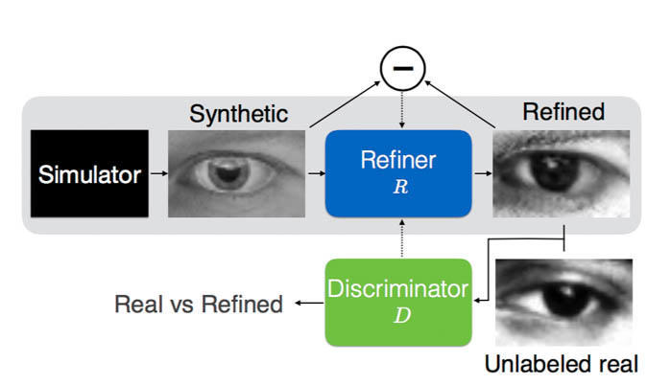
Baseline Model
SimGAN:
L1 self regularization
PatchGAN Local loss
3.Updating Discriminator using a
History of Refined Images

Slide 34
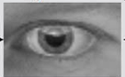
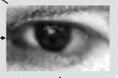
Baseline Model
Feature loss + GAN
VGG
VGG
L1Loss

Slide 35
Baseline Model
BiGAN
Y
Z
[Y Z]
Discriminator
Random
Noise
x
G(x)
[Y Z]
Discriminator
Z
Y
[x G(x)]
fake
real
[E(y) Y]
E(y)
Real image
Y

Slide 36
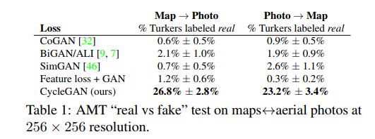
Comparison against baselines

Slide 37
Analysis of the loss functionm
Removing the GAN loss.
Removing the cycle-consistency loss.
We also evaluate our method with the cycle loss in only one direction:
GAN + forward cycle loss Ex∼pdata(x) [kF(G(x))−xk1],
GAN + backward cycle loss Ey∼pdata(y) [kG(F(y))−yk1

Slide 38
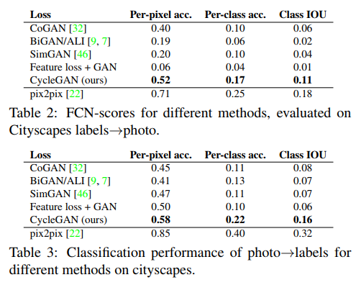
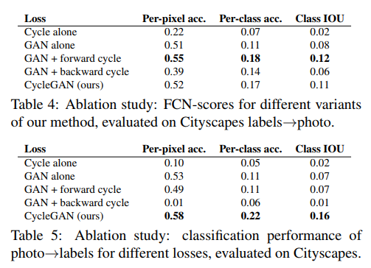
Analysis of the loss function

Slide 39
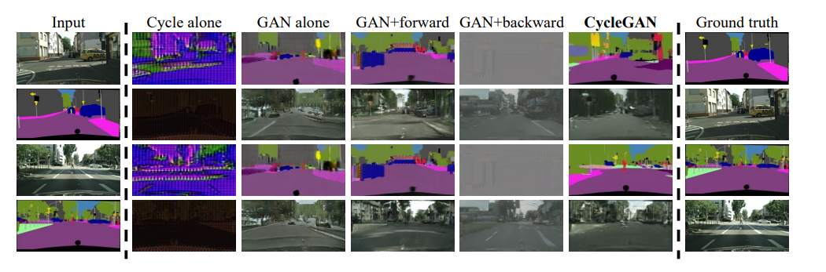
Analysis of the loss function - result

Slide 40
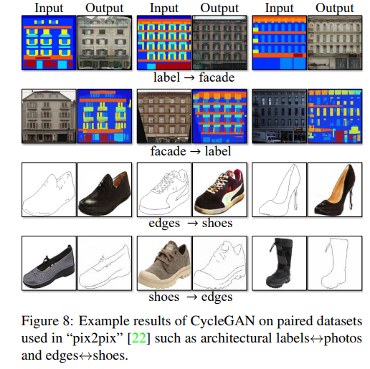
Additional results on paired datasets
The image quality of our results is close to
Those produced by the fully supervised
pix2pix while our method learns the
Mapping without paired supervision.

Slide 41
Applications
Collection style transfer
our method learns to mimic the style of an entire collection of artworks, rather than transferring the style of a single selected piece of art.
we can learn to generate photos in the style of, e.g., Van Gogh, rather than just in the style of Starry Night

Slide 42
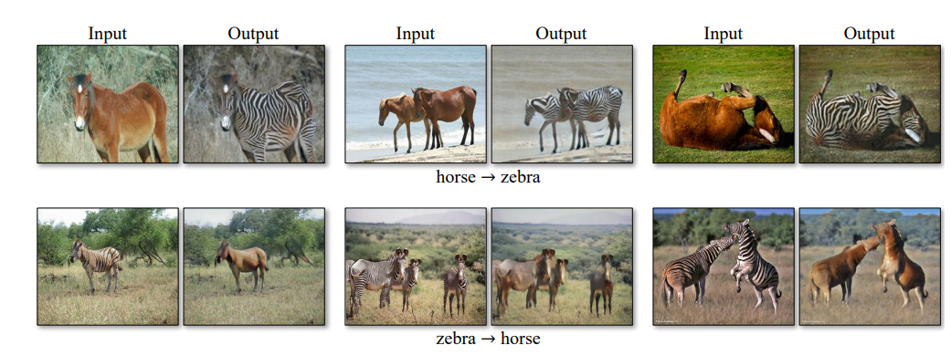
Applications
Object transfiguration

Slide 43
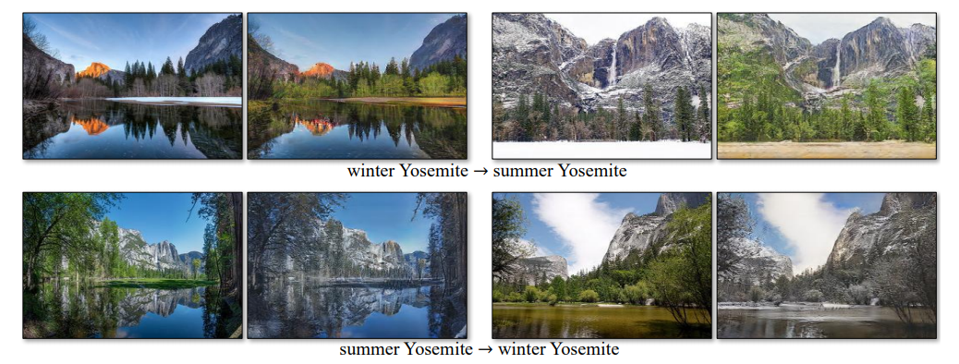
Season transfer

Slide 44
Photo generation from paintings
Photo generation from paintings
regularize the generator to be near an identity mapping when real samples of the target domain are provided as the input to the generator:
i.e., Lidentity(G, F) = Ey∼pdata(y) [kG(y) − yk1] + Ex∼pdata(x) [kF(x) − xk1

Slide 45
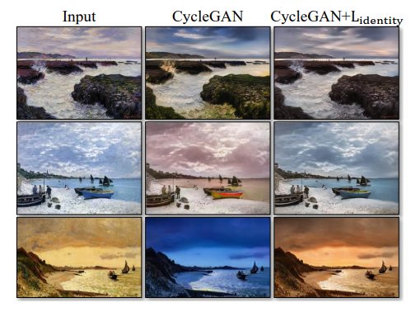

Slide 46
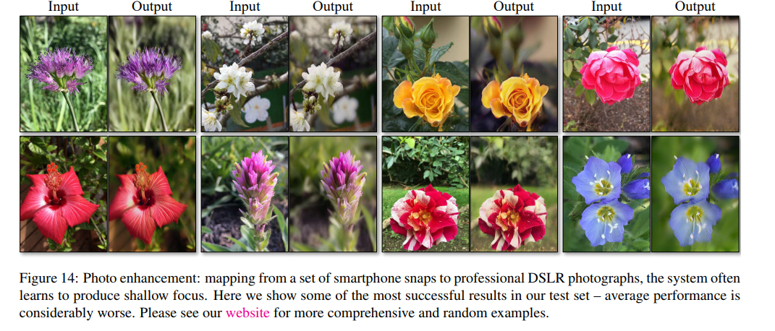
Photo enhancement

Slide 47
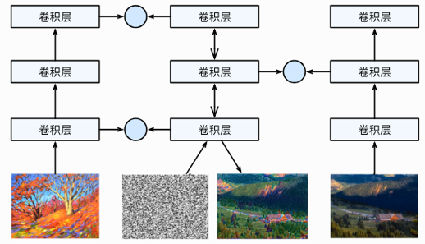
Image Style Transfer Using Convolutional Neural Networks
Gram matrix :
C x H x W
=> C x H*W X H*W x C
Style Loss
Content Loss
Conv
Conv
Conv
Conv
Conv
Conv
Conv
Conv
Conv

Slide 48
Limitations and Discussion
Although our method can achieve compelling results in many cases, the results are far from uniformly positive.
Handling more varied and extreme transformations, especially geometric changes, is an important problem for future work.

Slide 49
Limitations and Discussion
In some cases, this gap may be very hard – or even impossible – to close: for example, our method sometimes permutes the labels for tree and building in the output of the photos→labels task.

